Slide 1


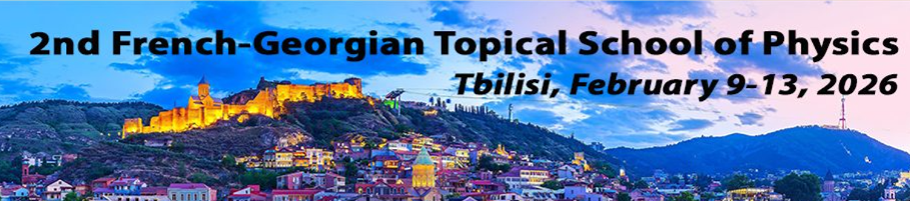
Observational Signatures of Ultra-Relativistic Flows in Astrophysics
Alexander Tevzadze
Evgeni Kharadze Georgian National Astrophysical Observatory, Abastumani, Georgia
09.02.2026

Slide 2
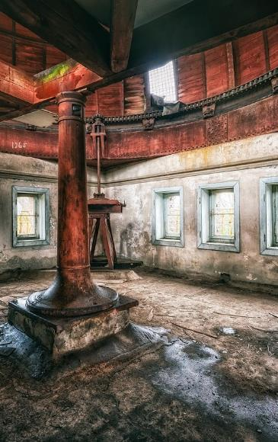
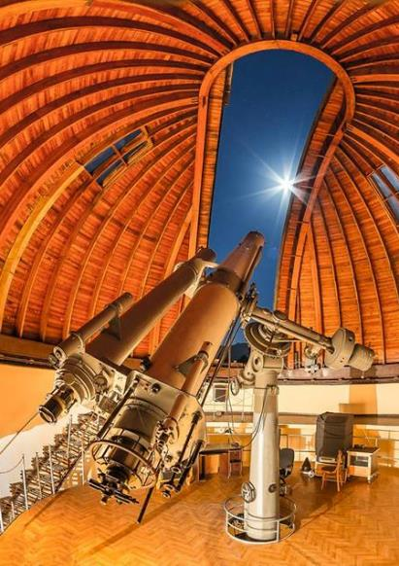
Evgeni Kharadze
Georgian National Astrophysical Observatory
Abastumani, Georgia

Slide 3
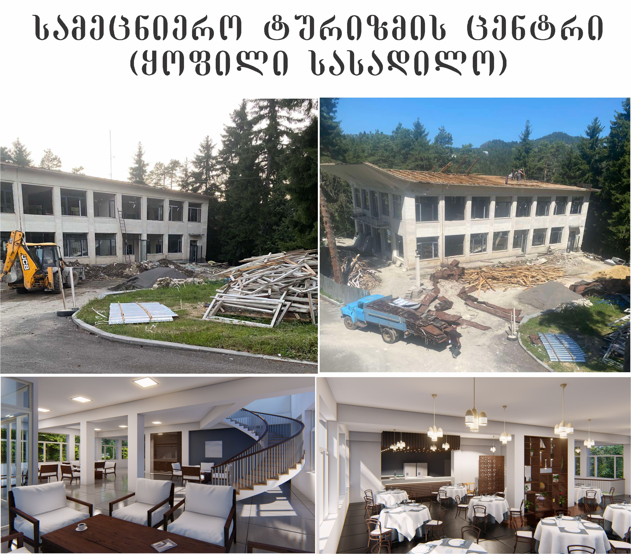
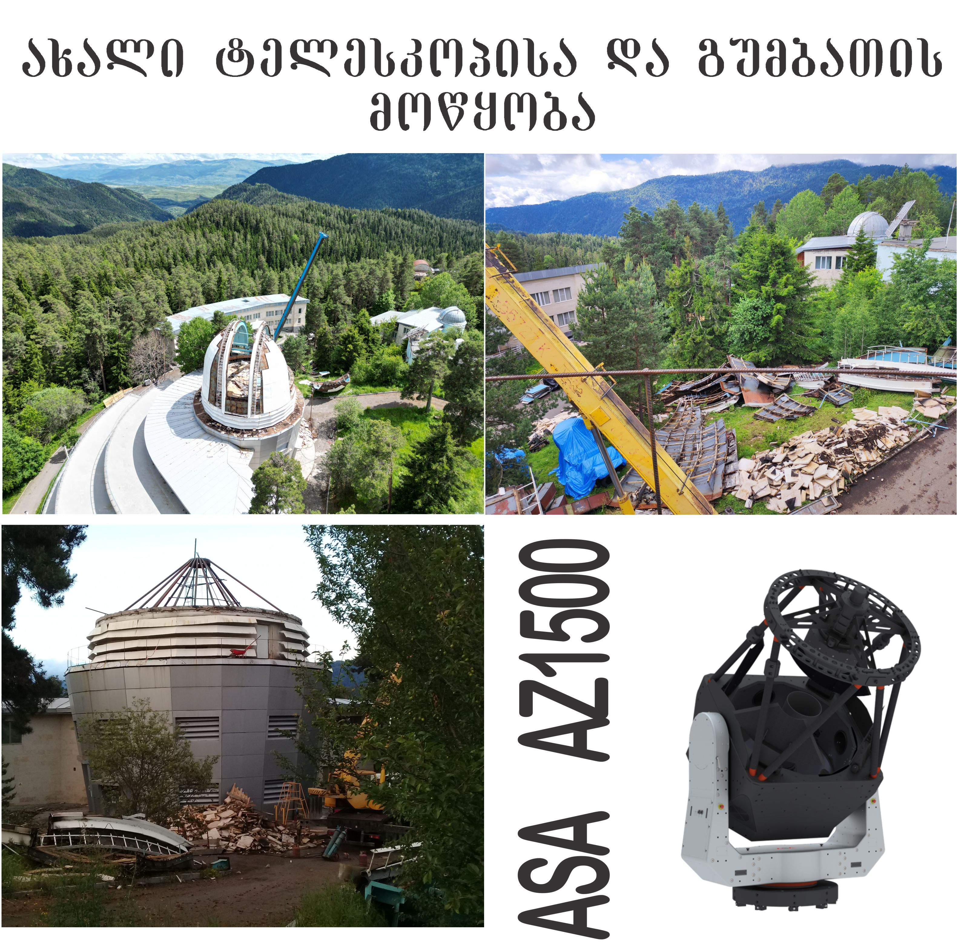
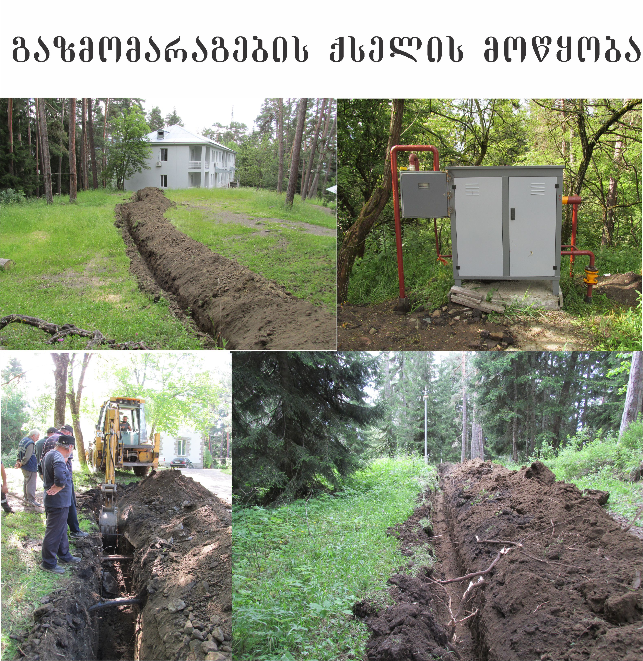
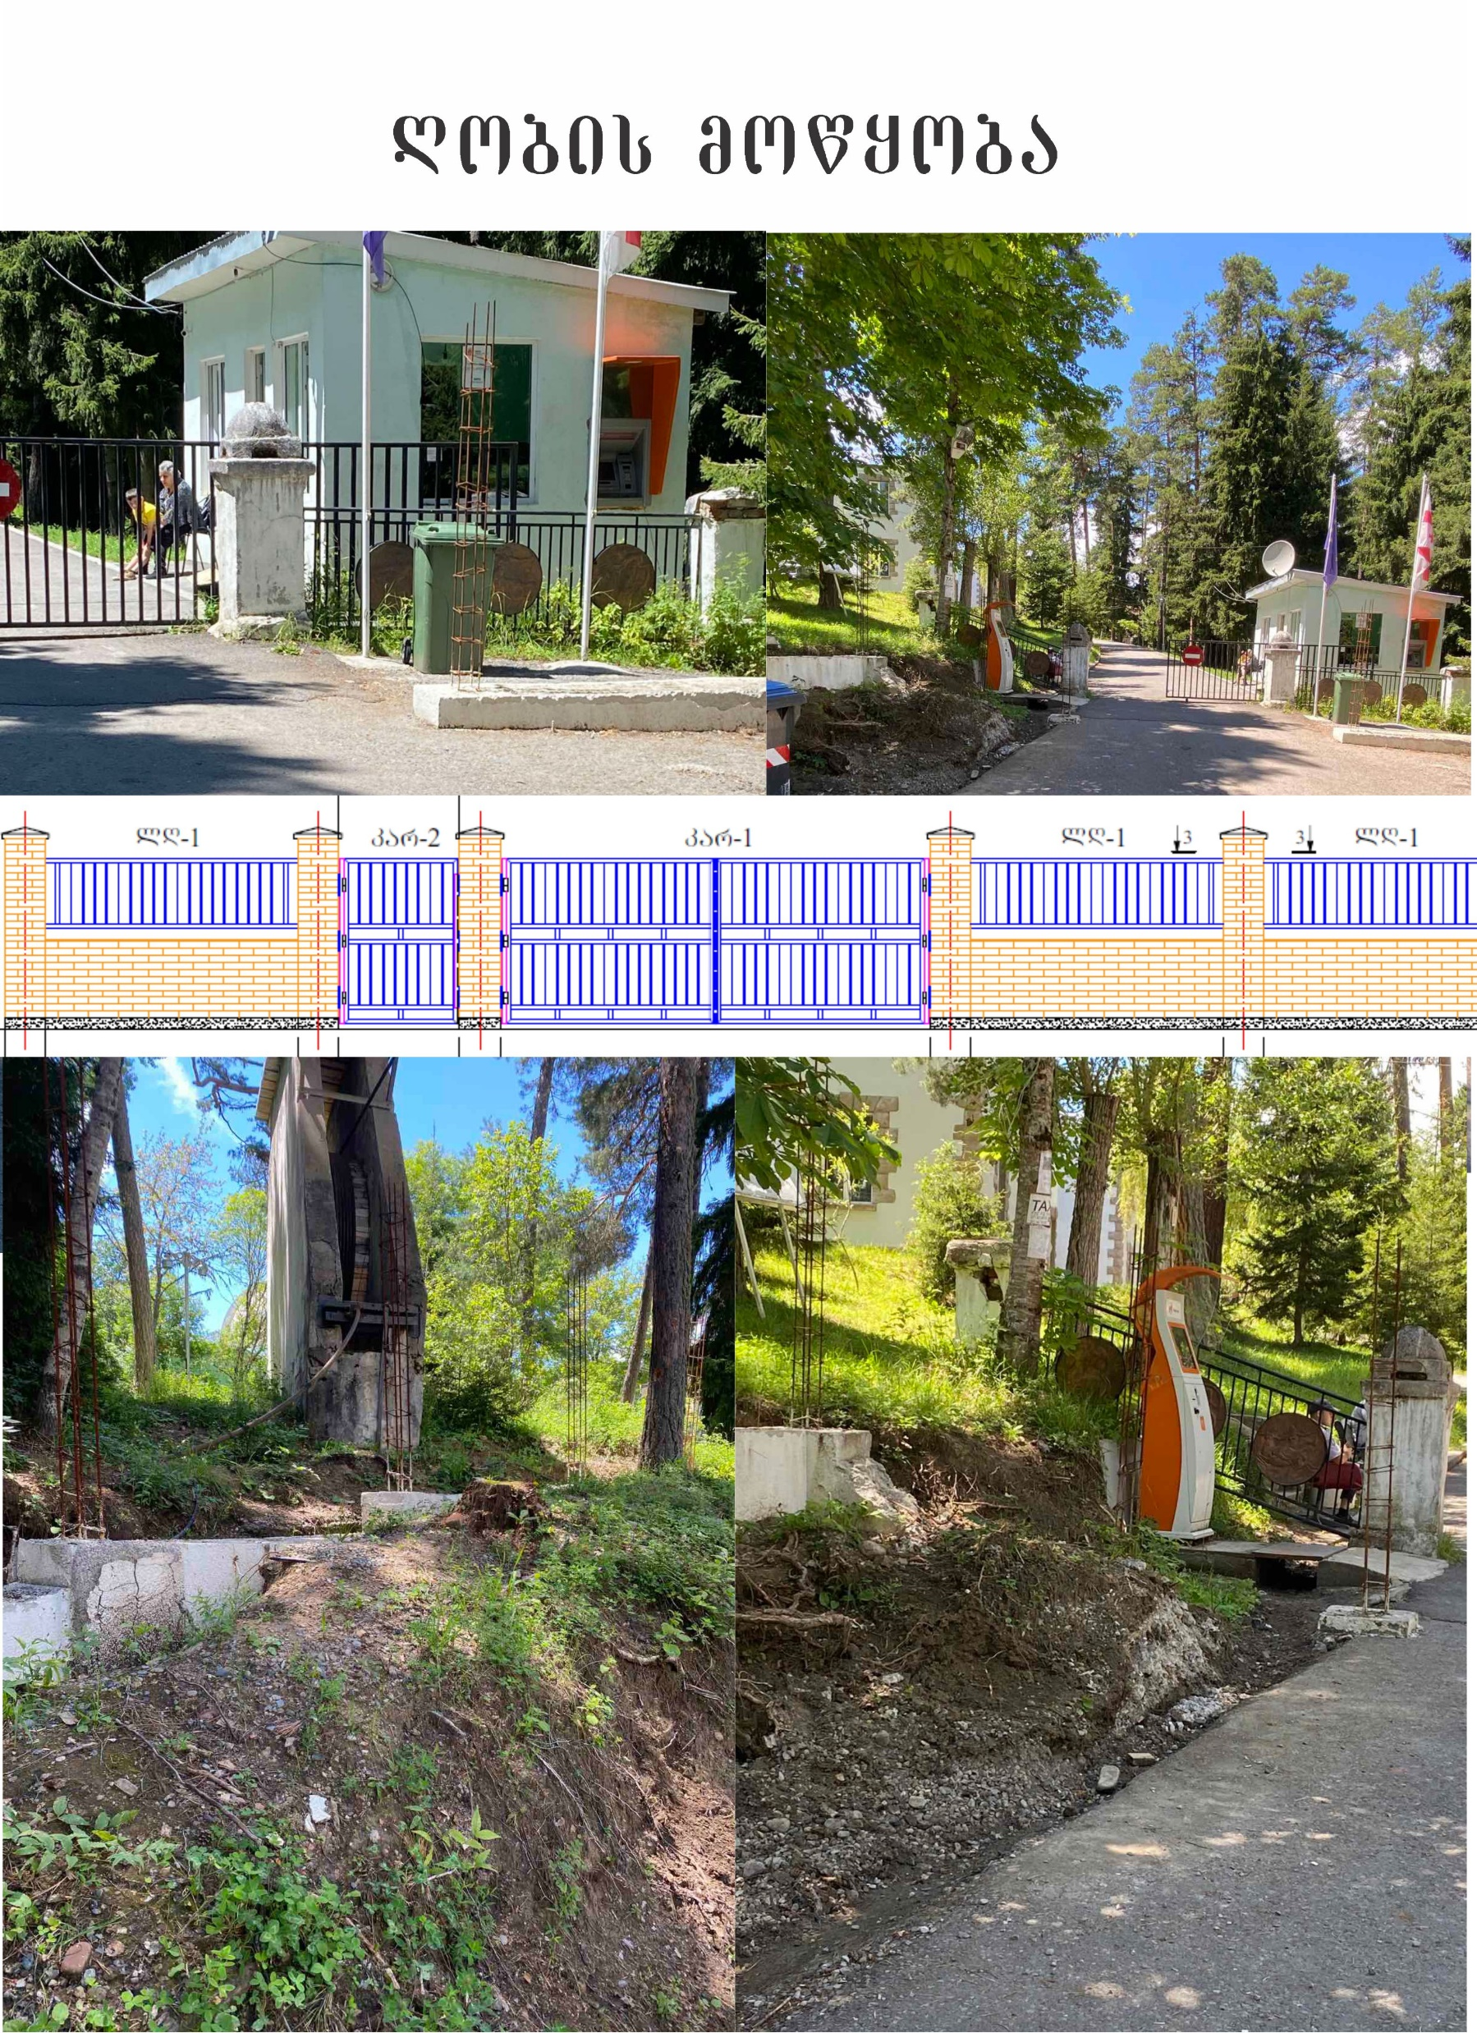
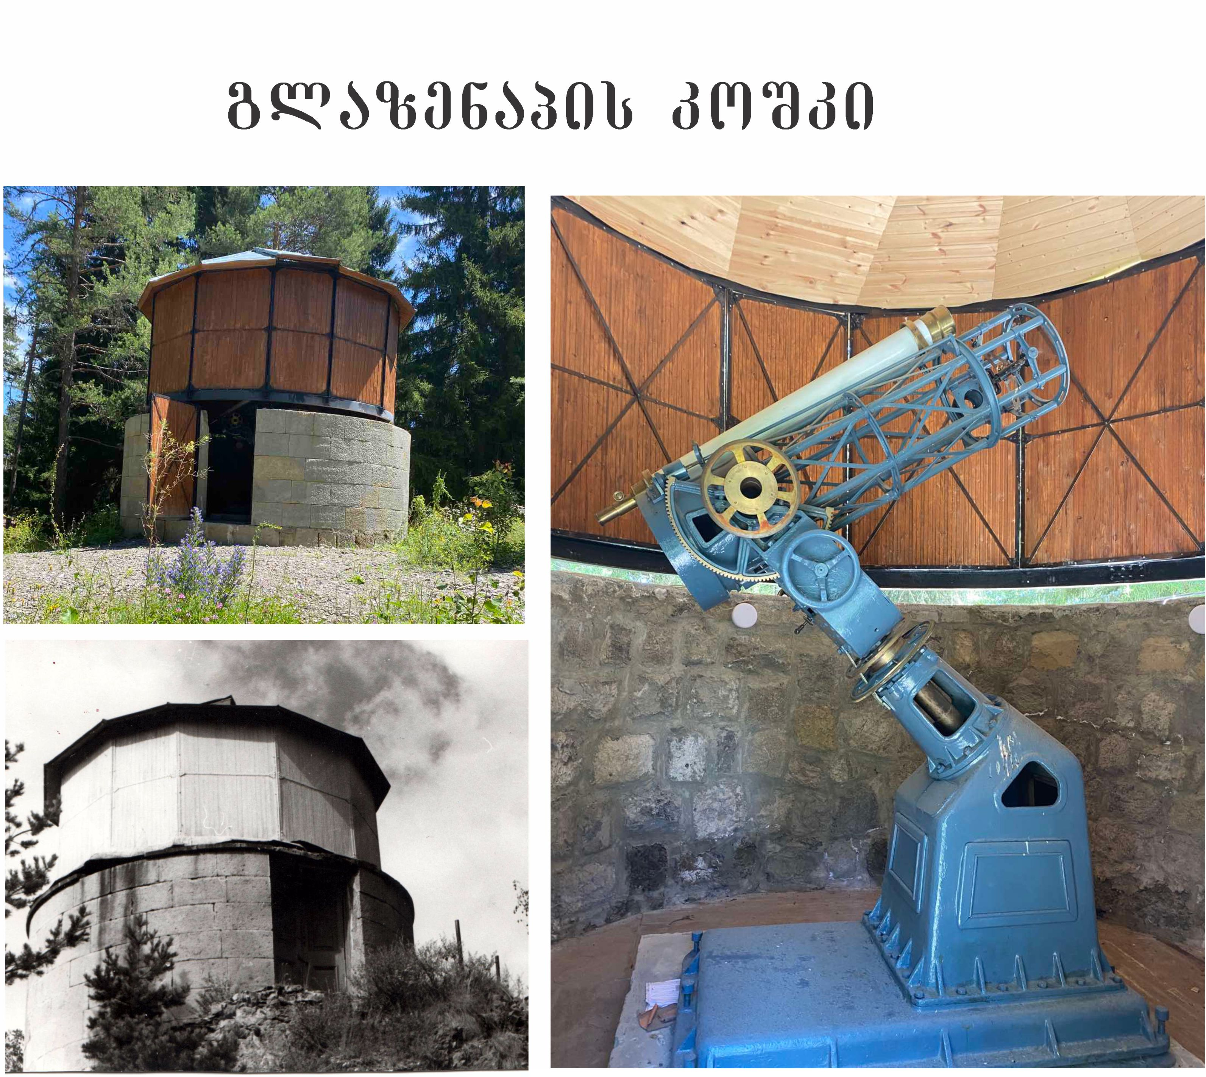
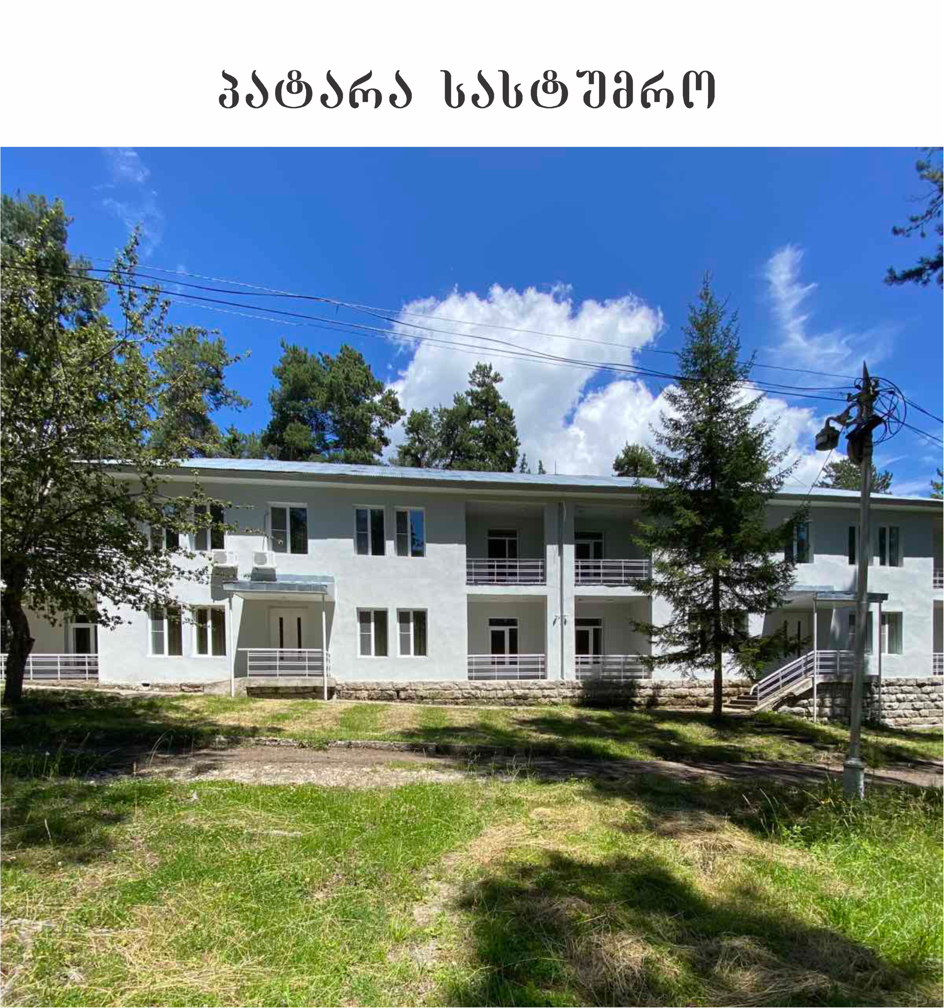
123
1
123
1
123
სსიპ - საქართველოს ევგენი ხარაძის ეროვნული ასტროფიზიკური ობსერვატორია

Slide 4

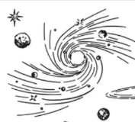

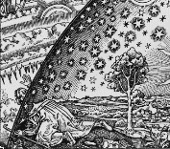
Scientific Departments in the Observatory
Scientific Departments
Galaxies and Stars
Sun and Solar System
Theoretical Physics and Cosmology
Evgeni Kharadze Georgian National Astrophysical Observatory
5

Slide 5
Research Topics
Galaxies and Stars
A study of variable stars and other transients
Study of active galactic nuclei at high energies
Search for optical companions of GW within the GRANDMA collaboration
Studying the physical characteristics of galaxies at different stages of evolution
Evgeni Kharadze Georgian National Astrophysical Observatory

Slide 6
Research Topics
Sun and Solar System
Observational study of dangerous asteroids approaching the Earth’s orbit
Solar Atmosphere/Magneto-seismology of the Solar Interior
Modelling and observations of solar and space weather processes
Study of physical processes in the solar chromosphere
Evgeni Kharadze Georgian National Astrophysical Observatory

Slide 7
Research Topics
Sun and Solar System
Magnetospheric heating and magnetocentrifugal effects in pulsars and other compact objects
Testing non-standard cosmological models by studying the physics of gravitational waves, primordial magnetic fields, dark energy and neutrinos
Formation of turbulence and coherent structures/flows in astrophysical disk shear flows
Dynamics of astrophysical disk shear flows - non-ideal magnetohydrodynamic effects
Evgeni Kharadze Georgian National Astrophysical Observatory

Slide 8
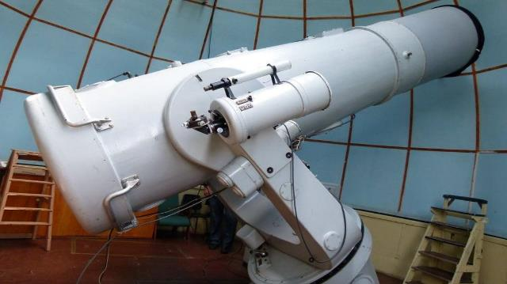
Scientific Facilities
Meniscus 70 cm-diameter Telescope
The Maksutov System Meniscus Telescope was installed in 1955.
Manufacturer: Leningrad Optical Mechanical Association - USSR
Wide-field, mirror-lens system. F-stop: f / 2.1
Meniscus lens diameter - 70 cm, Spherical mirror diameter - 98 cm
Focal length: the main mirror -210 cm, equivalent - 1050 cm
Telescope Capabilities
Designed to observe various objects in the night sky
Performs Photometric or Spectrophotometric measurements
Equipped with Different Refractive Index Prisms (1, 2, 4, 8 degrees)
Allows spectral classification of stars
Enables detection of objects in special class
Evgeni Kharadze Georgian National Astrophysical Observatory

Slide 9
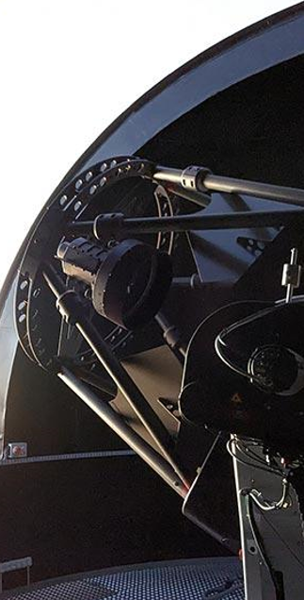
Observatory Telescope Upgrade
New Telescope
New major telescope in over 50 years: special funding from government to replace:
1.25-meter-diameter AZT 11
1.5-meter-diameter Austrian-made robotic telescope
Modern spectrographic interface
Existing Telescopes
Still in operation:
Meniscus 70-cm Telescope
AZT 14 telescope
Double Astrograph
Big Coronagraph
Evgeni Kharadze Georgian National Astrophysical Observatory

Slide 10
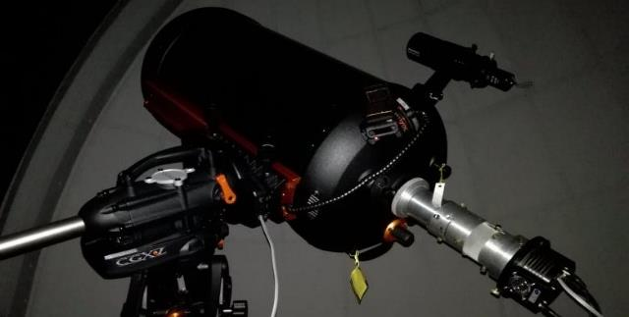
Scientific Facilities
Schmidt-Cassegrain Telescope
The Schmidt-Cassegrain System telescope, with automatic control was installed in 2018.
Manufacturer - Celestron
Correction Plate diameter - 36 cm.
Focal length: the main - 200 cm, equivalent - 400 cm.
Mainly used for the Polarimetric and Photometric study of celestial bodies.
Evgeni Kharadze Georgian National Astrophysical Observatory

Slide 11
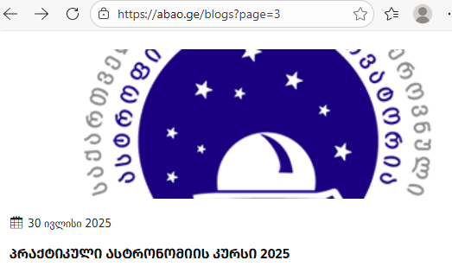
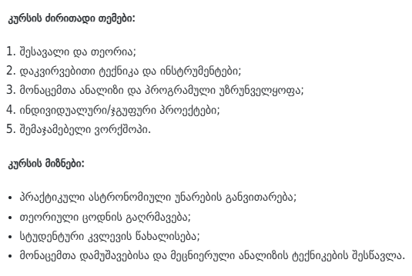

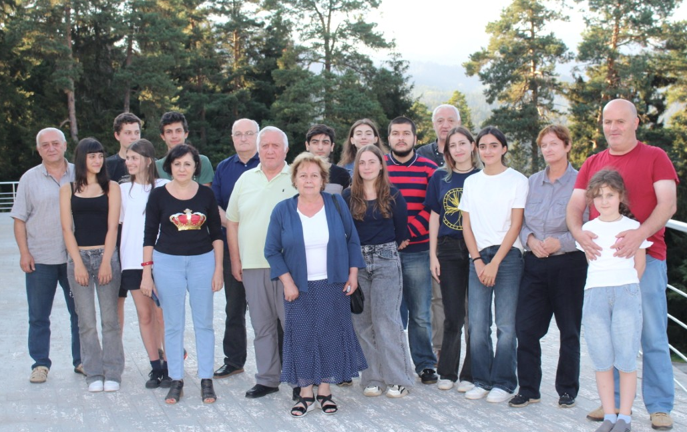
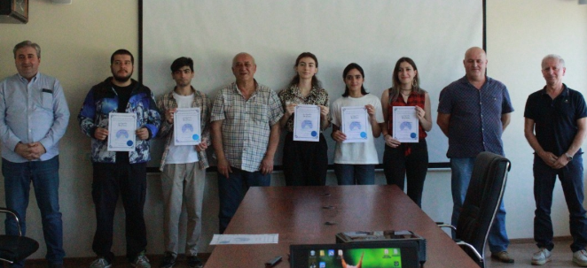
Abastumani Practical Astronomy Course
1st week of August
Second French-Georgian Topical School of Physics, Tbilisi 09.02.2026

Slide 12
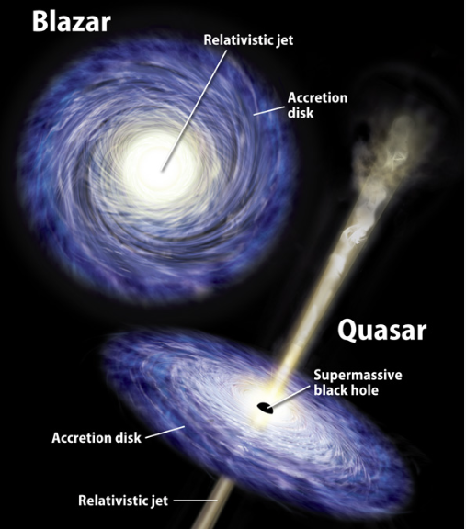
Relativistic Flows in Nature
Relativistic flows appear whenever gravity, rotation, and magnetic fields combine efficiently
Source of energy: gravitation!
Blazars (jets directed towards us)
Quasars (jets towards us/small angles)
Radio Galaxies (almost normal viewing angles)
Black hole accretion disks
Gamma Ray Busts
Pulsar winds
Supernova – shock shells
Second French-Georgian Topical School of Physics, Tbilisi 09.02.2026

Slide 13
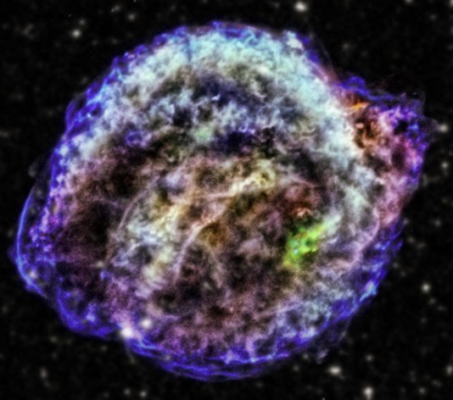
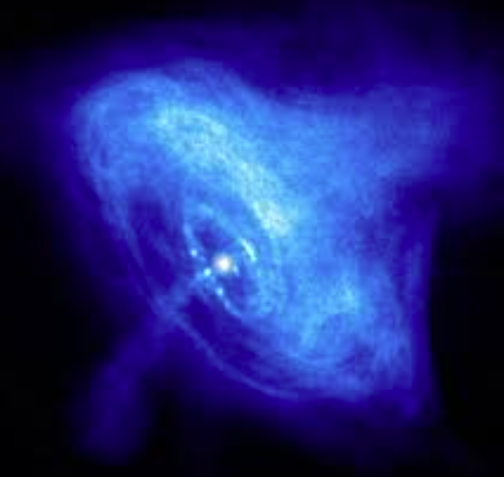
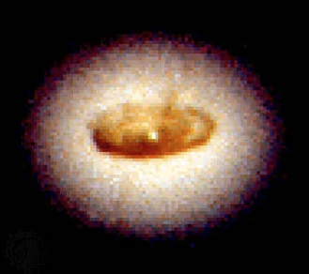
Supernova - Pulsar Wind - Accretion Disk
Second French-Georgian Topical School of Physics, Tbilisi 09.02.2026

Slide 14
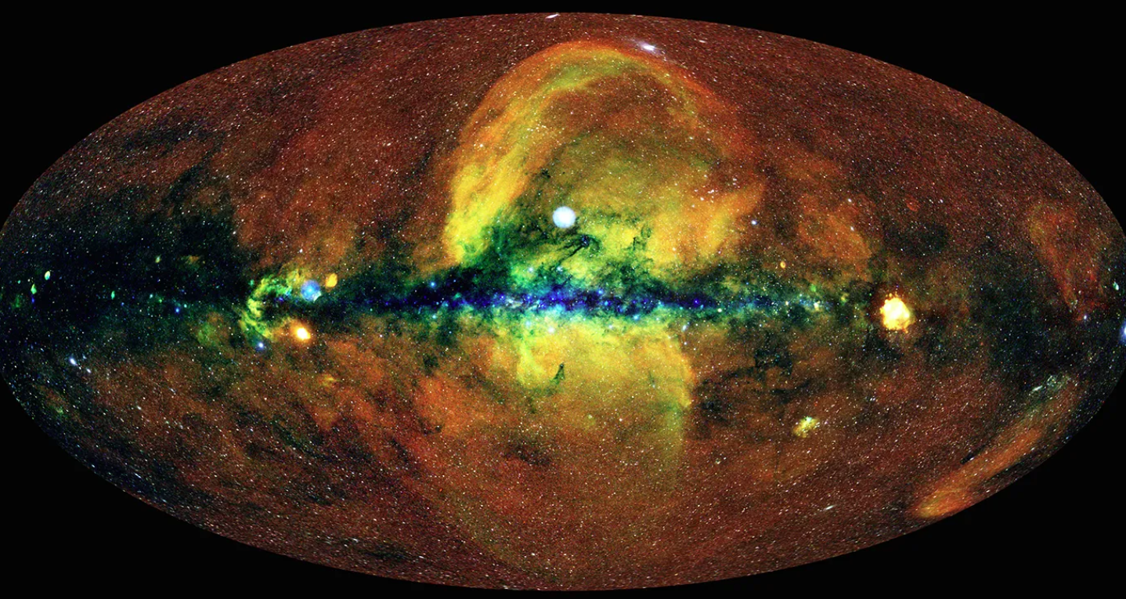
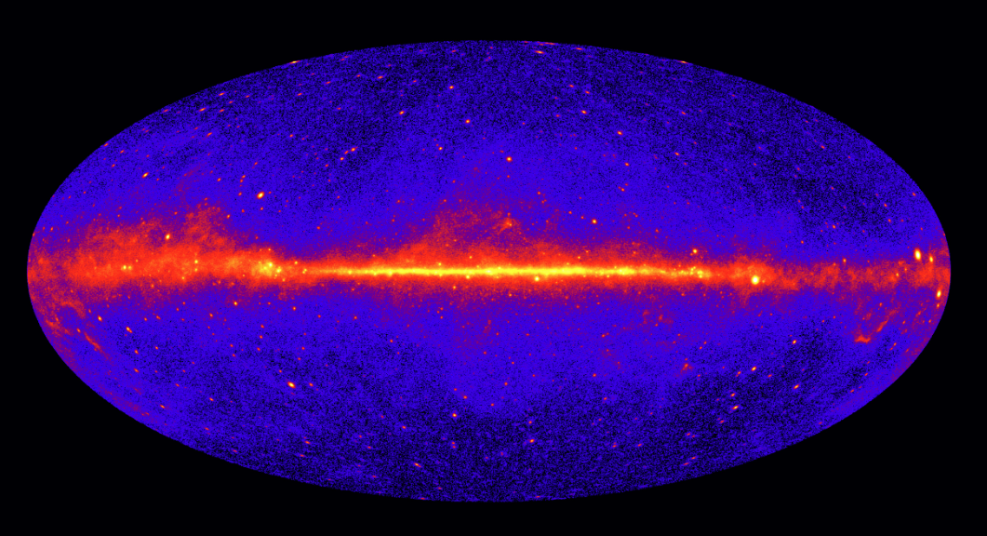
X-ray Sky - Gamma-ray Sky
Second French-Georgian Topical School of Physics, Tbilisi 09.02.2026

Slide 15
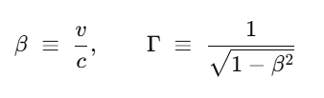


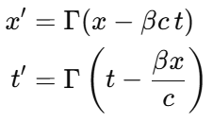

Ultra Relativistic Flows
Relativistic Flows - Lorentz Gamma factor:
Ultra Relativistic regime:
Lorentz coordinate transformation:
V = Vx (1D)
Speed | Gamma
0.5 c | 1.15
0.9 c | 2.3
0.99 c | 7
0.999 c | 20
0.9999 c | 70
Second French-Georgian Topical School of Physics, Tbilisi 09.02.2026

Slide 16
Relativistic Flows in Nature
Bulk Flow Particle Flow
Relativistic
Ultra-Relativistic
OBJECT | Typical Gamma
Supernova Ejecta | 1 - 2
Type Ia Supernova | 2-10
Radio Galaxies | 5-10
Quasars | 10-20
Blazars | 10-50
GRB | 100-1000
OBJECT | Typical Gamma
Cosmic-ray electrons | 10³–10⁶
Pulsar wind pairs | 10⁴–10⁶
AGN jet electrons | 10³–10⁵
GRB shock electrons | 10⁴–10⁶
Large Hadron Collider | 7000-7500
Ultra High Energy Cosmic Rays (protons) | 10⁹–10¹¹
Second French-Georgian Topical School of Physics, Tbilisi 09.02.2026

Slide 17
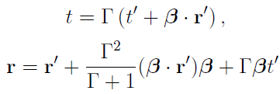

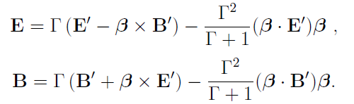
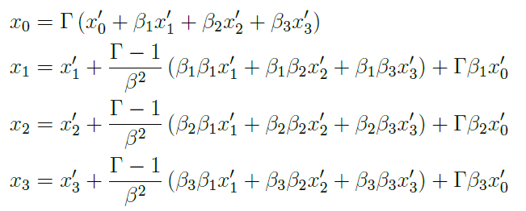

General Configuration
Lorentz coordinate transformation:
Electric and Magnetic field transformation:
Individual
Components
Lorentz mixing of temporal and special coordinates
Invariant:
Second French-Georgian Topical School of Physics, Tbilisi 09.02.2026

Slide 18
Relativistic Effects in Nature
Non-trivial observational effects of Lorentz transformation revealed in different astrophysical objects
EFFECT | MECHANISM
Superluminal Motion | light-travel-time projection effects
Terrell–Penrose Rotation | relativity of simultaneity
Relativistic Beaming | angular compression of emission
Relativistic Aberration | Lorentz transformation of angles
Doppler boosting | frequency–intensity mixing
Lorenz Variability/pulsations | time-space coordinate mixing
Second French-Georgian Topical School of Physics, Tbilisi 09.02.2026

Slide 19
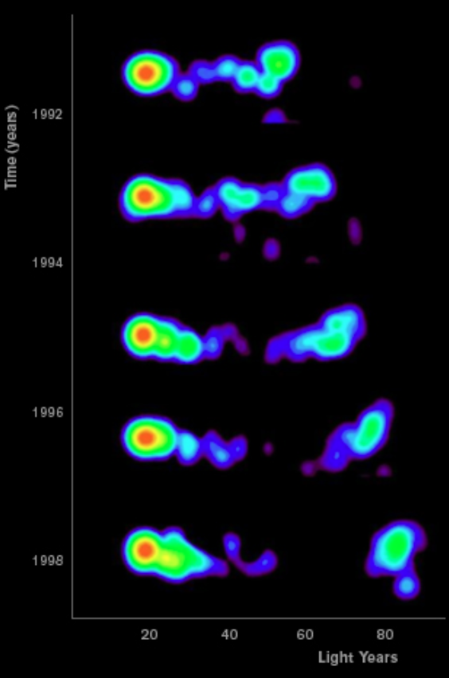
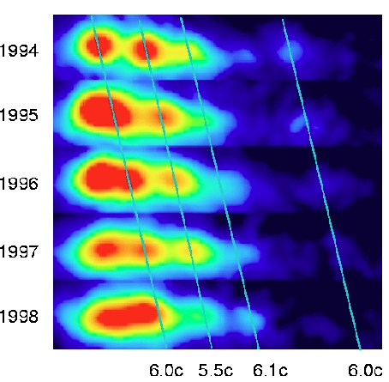
Superluminal Motion
Quasar 3C 279 M87 Jet
(~ 5c, 1971)
Γ = ???
Second French-Georgian Topical School of Physics, Tbilisi 09.02.2026

Slide 20
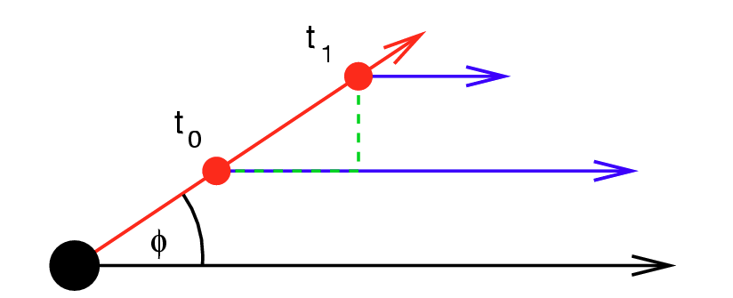
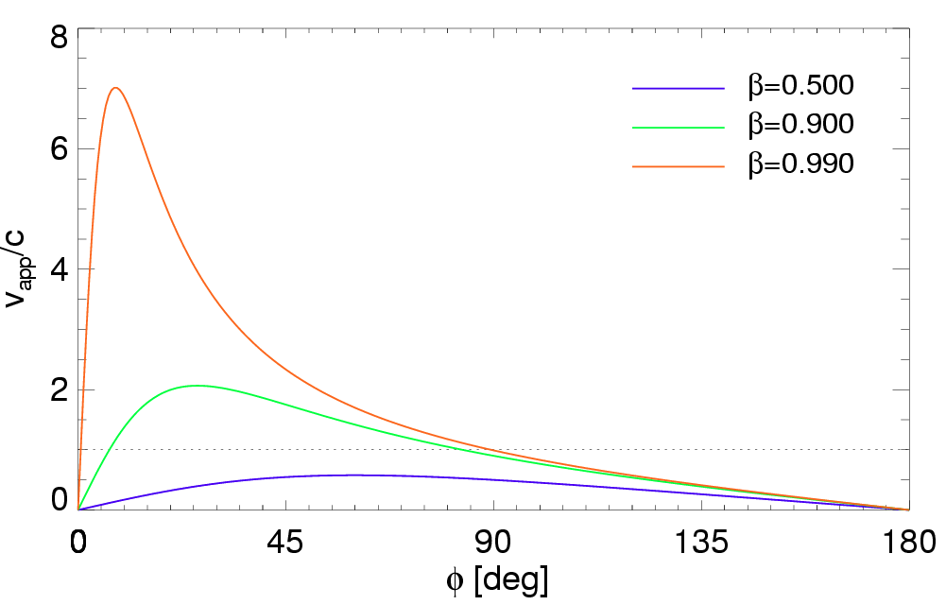



Superluminal Motion
Relativistic
Projection
+
Light Travel Time
Γ = 20
Jet
Observer
Second French-Georgian Topical School of Physics, Tbilisi 09.02.2026

Slide 21

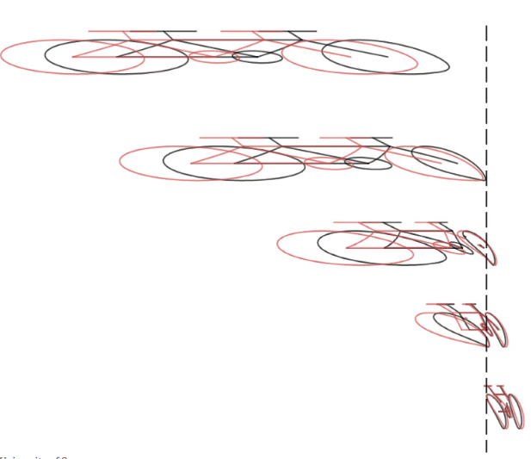
Gamow’s Cyclist
How observer sees cyclist moving by with relativistic velocity?
Second French-Georgian Topical School of Physics, Tbilisi 09.02.2026

Slide 22
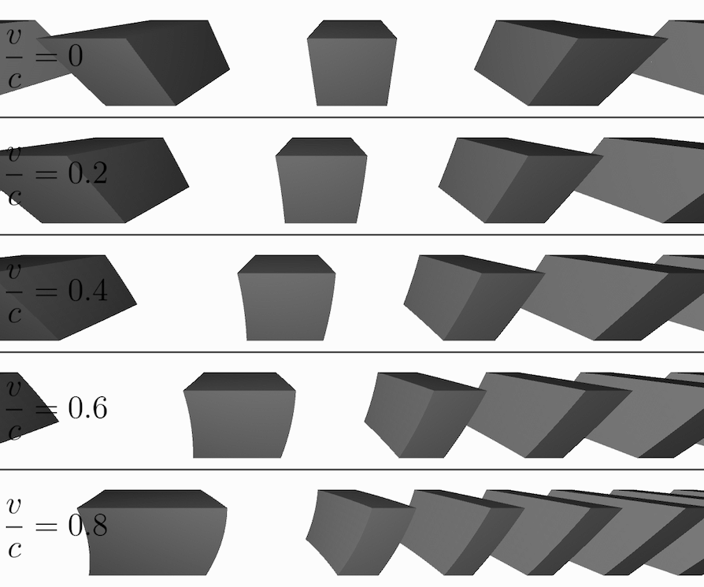
Terrell-Penrose “Rotation”
Numerical Modelling
3D Object
Second French-Georgian Topical School of Physics, Tbilisi 09.02.2026

Slide 23
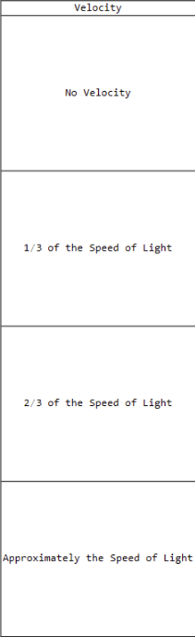
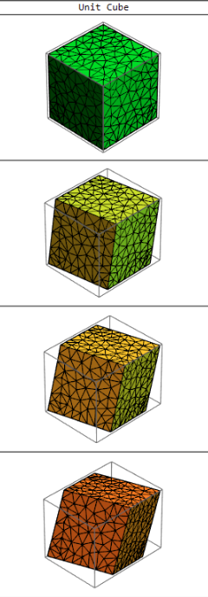
Terrell-Penrose Effect
Angle between
Velocity and geometric axis
Second French-Georgian Topical School of Physics, Tbilisi 09.02.2026

Slide 24
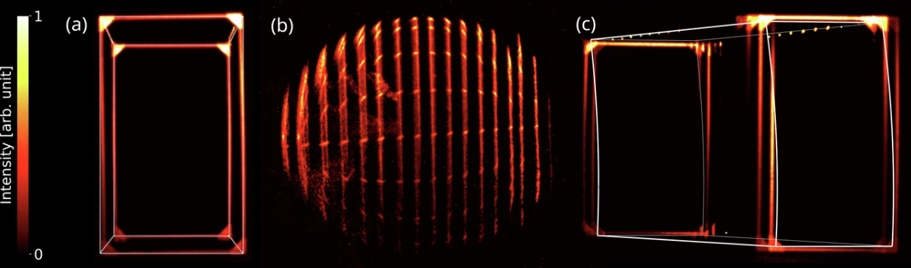
Terrell Rotation at v=0.999c
Experimental Result Γ=20
Second French-Georgian Topical School of Physics, Tbilisi 09.02.2026

Slide 25
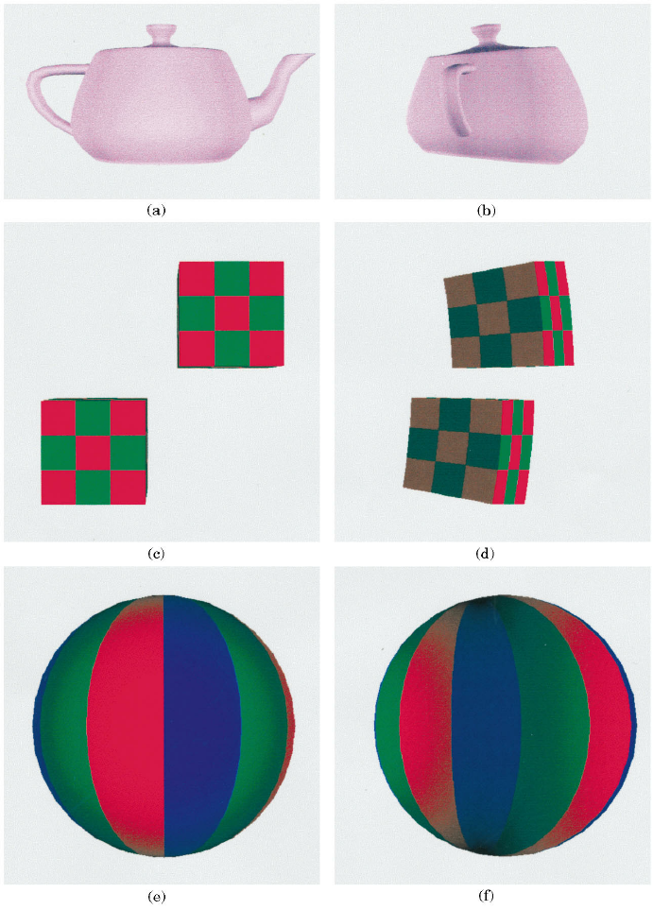
Terrell’s rotation
Can we see the back of the object?
Astrophysical Objects
Flow morphology
Jet knots
Expanding spherical shells
relativity of simultaneity in observed morphology
Second French-Georgian Topical School of Physics, Tbilisi 09.02.2026

Slide 26
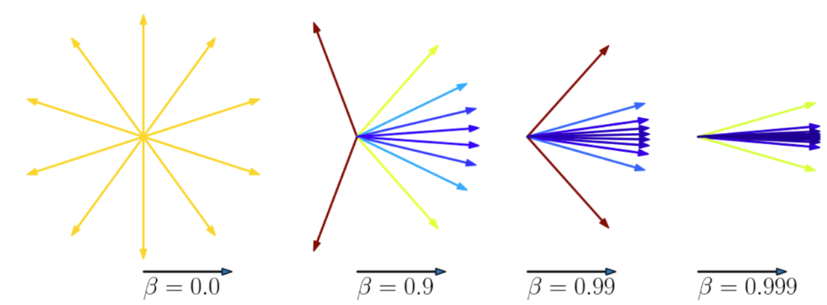
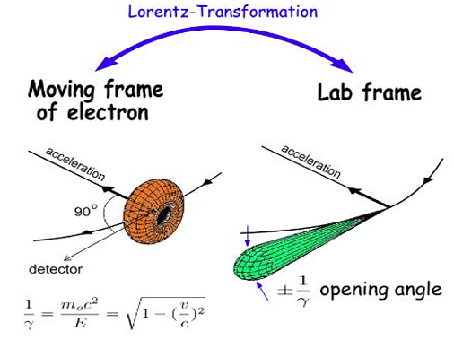
Relativistic Aberration
Relativistic Doppler shift
“Lorenz Beaming”
Cyclotron vs Synchrotron emission
φ ~ 1/Γ
Second French-Georgian Topical School of Physics, Tbilisi 09.02.2026

Slide 27
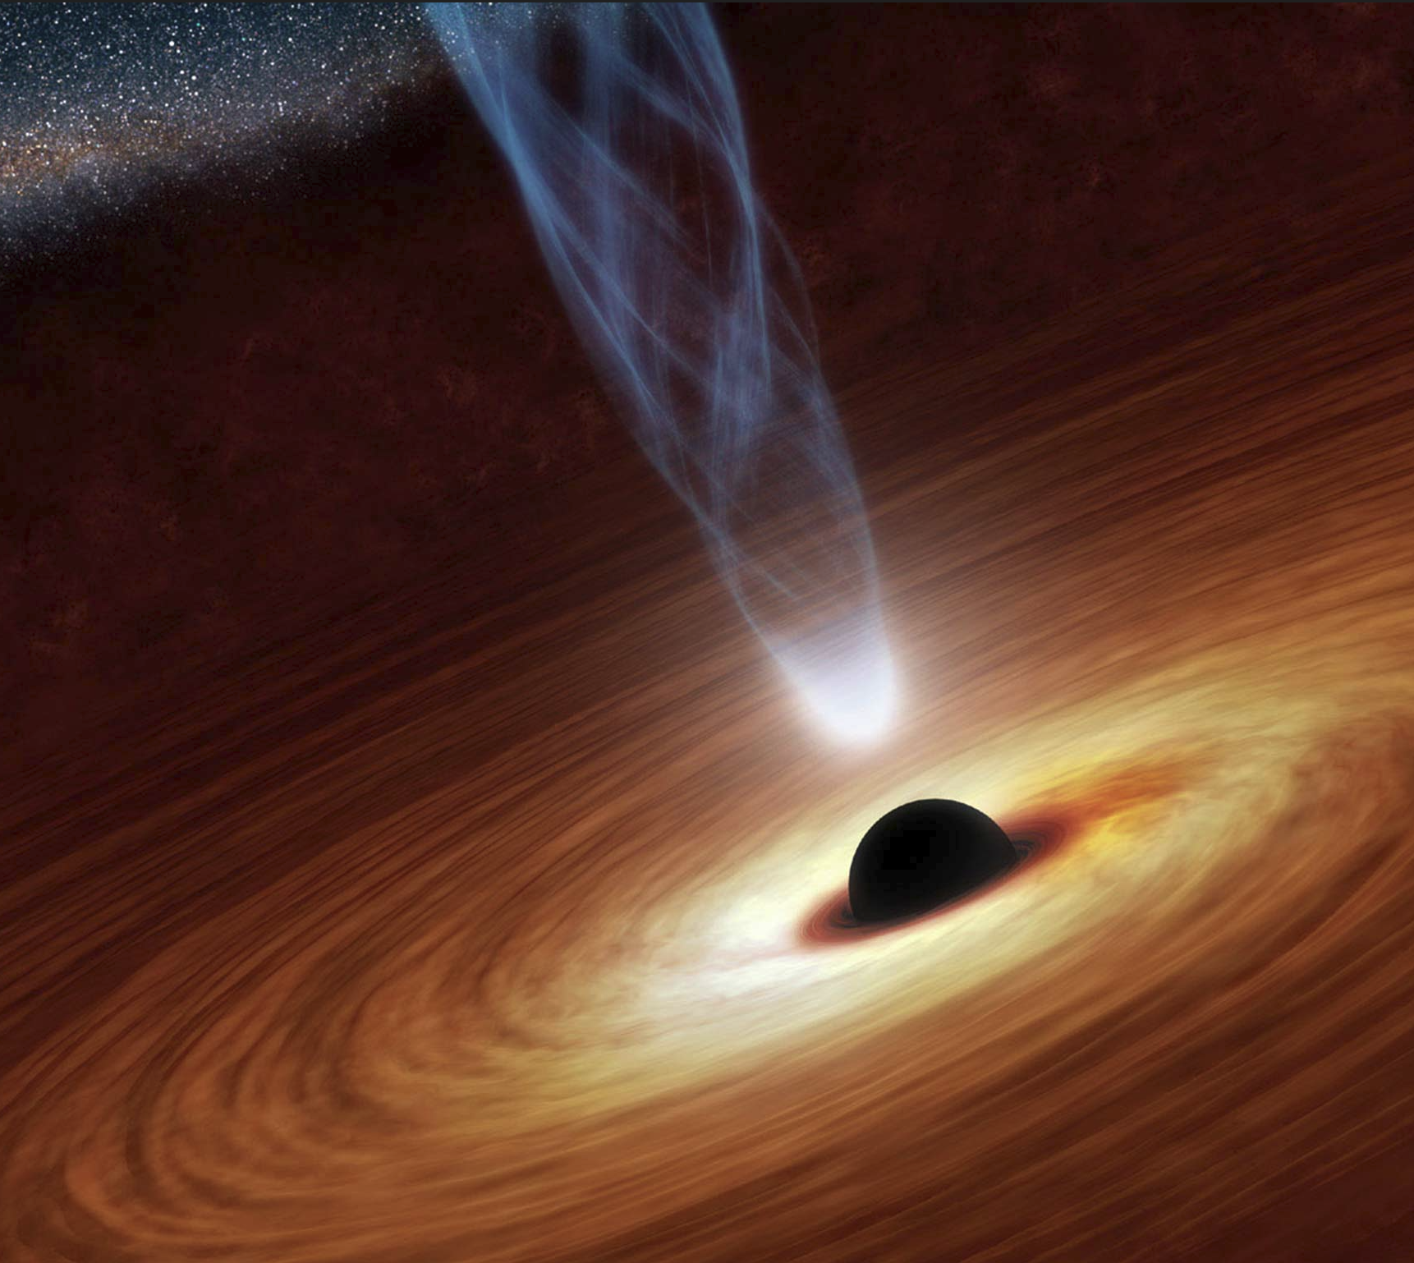
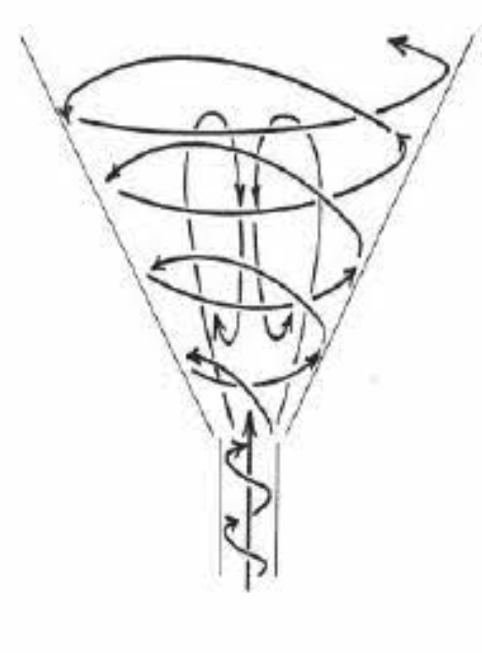
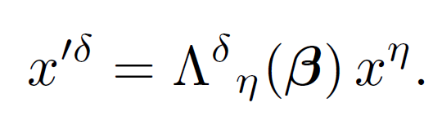
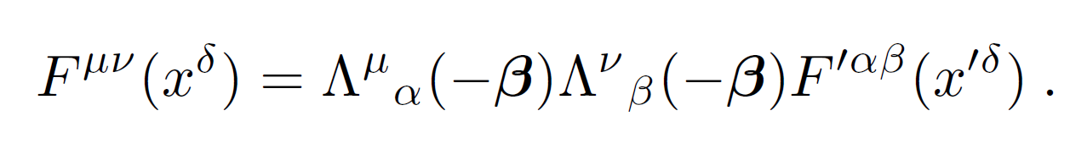
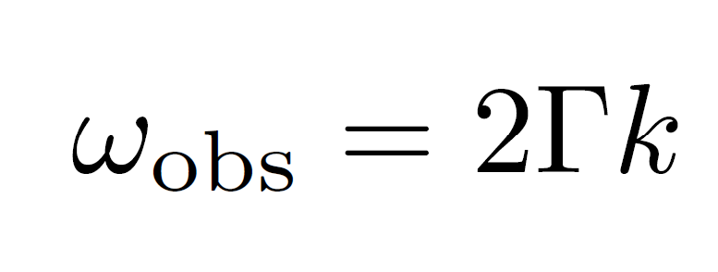
Lorentz Pulsations
Jet outflow:
Stationary swirling flow
Vertical spatial variation -> Time variation
Observational Pulsations (infinity):
Second French-Georgian Topical School of Physics, Tbilisi 09.02.2026

Slide 28
Ultra-relativistic effects
Human intuition is non-relativistic
Lorentz transformation introduces simple concepts for simple geometric shapes
Realistic Objects through Lorentz lense (relativistic aberration) look WEIRD
Reconstructing the source requires undoing relativistic aberration - otherwise the inferred geometry and speeds are wrong
Second French-Georgian Topical School of Physics, Tbilisi 09.02.2026

Slide 29
Questions?
Second French-Georgian Topical School of Physics, Tbilisi 09.02.2026

Slide 30
The Title
text
Second French-Georgian Topical School of Physics, Tbilisi 09.02.2026

